Slide 1
Genetic Algorithms and XO Skin
An AI system for questionnaire-based product recommendation

Slide 2
What are genetic algorithms?
A Family of computer algorithms (digital recipes for problem solving) with roots on ai research
First proposed and studied by computer scientist john Henry holland in the mid-1970's (university of Michigan, Ann arbor)
They're based on how biological organisms favor genetical changes that make them more fit, problem components are modeled as genes and a genome, natural selection modeled as mathematical functions that evaluate the evolving genome
Good for solving problems that aren't easily modelled by yes/no questions
Used nowadays in automotive design, telecommunications, shipment routing, finance and investment strategies, marketing and merchandising

Slide 3
Why genetic algorithms and XO Skin?
XO Skin plans to recommend products based on the customer's skin type and climate among other factors
Hard-coded (e.g. lookup-table) based solutions will not scale (data entry and hard-coding becomes intractable (undoable) as the list of products increases)
Product recommendation formulation is amenable (well-adapted) to a genetic algorithm (AI) solution approach
I specialized in the study of such algorithms in college and have written and published a framework (API) for applying such algorithms to general problems
I wrote a specialized library using this api (adaptive computing framework) to solve the product recommendation problem for xo skin
Because it works, it's cool, and gives us "ai-cred" (increasing brand marketability) ("Got AI?")

Slide 4
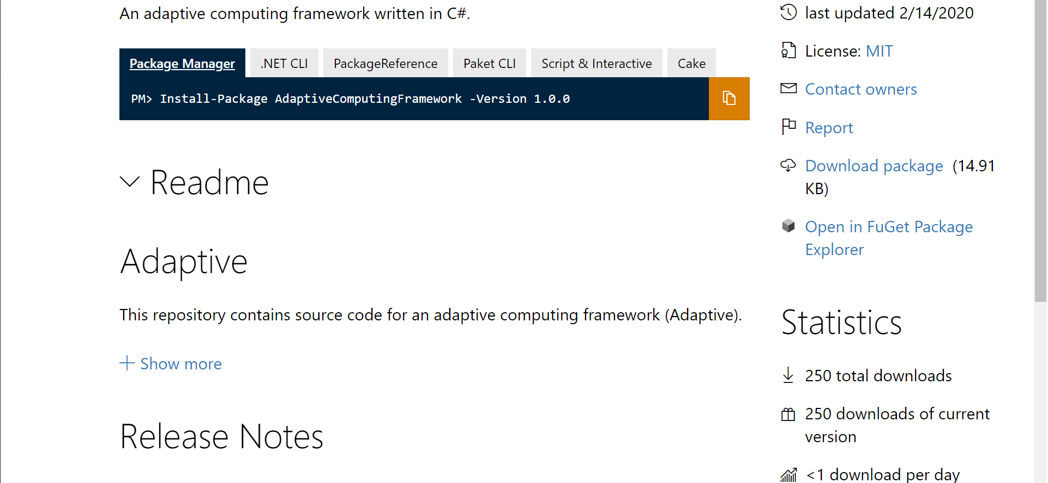
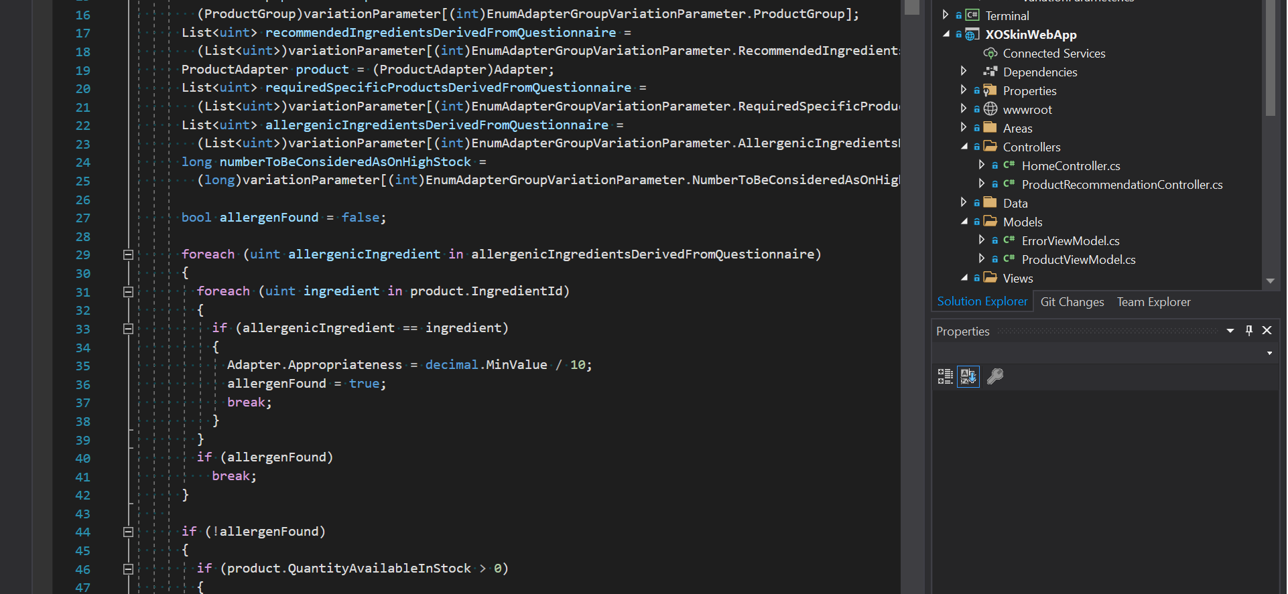
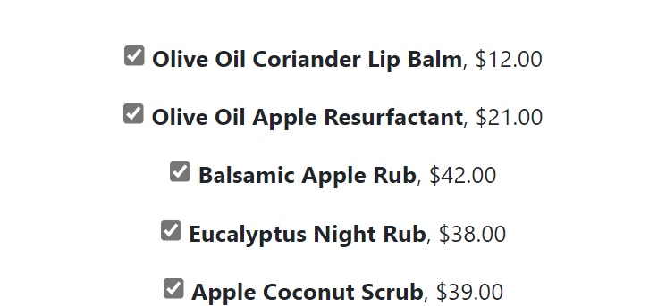
Why genetic algorithms and xo skin?
Adaptive computing framework
Adapted to xo skin
Integrated into Xo Skin web application
Available on nuget.org written and published by me
Code written, tested and debugged to integrate the GA API with XO Skin's product recommendation challenge
Code has been written tested and debugged and is already integrated into the XO Skin Web application

Slide 5
Tech-DEMO
(please stand-by)

Slide 6
We like it? What do we do next?
SME (subject matter expert): please complete column with ingredients as they relate to the answer to a question in the questionnaire. "XO SKIN_DIAGNOSTIC_QUESTIONNAIRE matrix_V5.xslx"
Medium-long term
SME (subject matter expert), everyone: come up with additional ideas for algorithm data points (criteria that algorithm should use to make good recommendations). These don't need to be mathematical equations, plain English will do

Slide 7
Reference
"Genetic algorithms: Computer programs that 'evolve' in ways that resemble natural selection, can solve complex problems even their creators do not fully understand" (john henry holland) https://www.cc.gatech.edu/~turk/bio_sim/articles/genetic_algorithm.pdf
NuGet gallery: adaptive computing framework (MIT-Licensed open-source, written by me) https://www.nuget.org/packages/adaptivecomputingframework/
XO skin web application code (XO SKIN, CORP., q8 worldwide) https://dev.azure.com/knightsofavalon/_git/XO/commits

Slide 8
Questions?

